Slide 1
Medical physics –first year
L3&L4
Thermoregulation &Heat in Medicine
By Assistants professor
Dr.Mohammed Ali Jaber
Physiology Department
College of Medicine
University of Basrah

Slide 2
Heat in Medicine
Objectives:
At the end of the lecture the student will be learning
Heat and kinetic energy
What is thermoregulation?
Thermometry and temperature scales
Types of thermometers and its application in medicine
Heat Therapy
The physical methods of producing heat in the body

Slide 3
Heat and low temperature
Heat is thermal energy transferred from system to another, it is measured in calories or joules. (1calories=4.186joules)
One Calories ; The amount of heat required to raise one gram of water 1° Celsius.
Temperature is the measure of hotness or coldness of matter., or is the average kinetic energy per molecule of a substance.
Temperature is measured in degrees on the Celsius (C) or Fahrenheit (F) scale, or in kelvins (K).

Slide 4
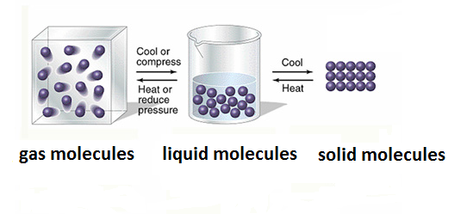
The average kinetic energy (K.E) directly proportional to temperature
K.E α T
Heat can be remove from a substance to lower the temperature. Low temperature referred to as the cryogenic region (absolute zero,-273.15°c).

Slide 5
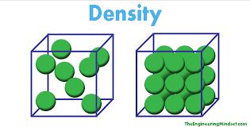
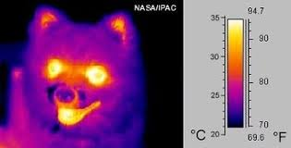
Thermometry and temperature scales
Temperature is difficult to measure directly, so we usually measure it indirectly by measuring one of many physical properties that change with temperature, such as ;
Electrical resistance
volume (density) increases
The emission of infrared radiation.
Color

Slide 6
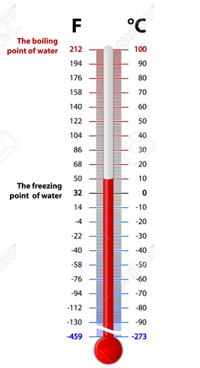
Temperature scales
1-Fahrenheit scale(°F):
In this scale the freezing temp. is 32°F ,
Boiling point is 212°F ,
Normal body temp. is about 98.6°F
(0)°C=(5/9)((T°F)-32)

Slide 7
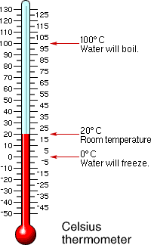
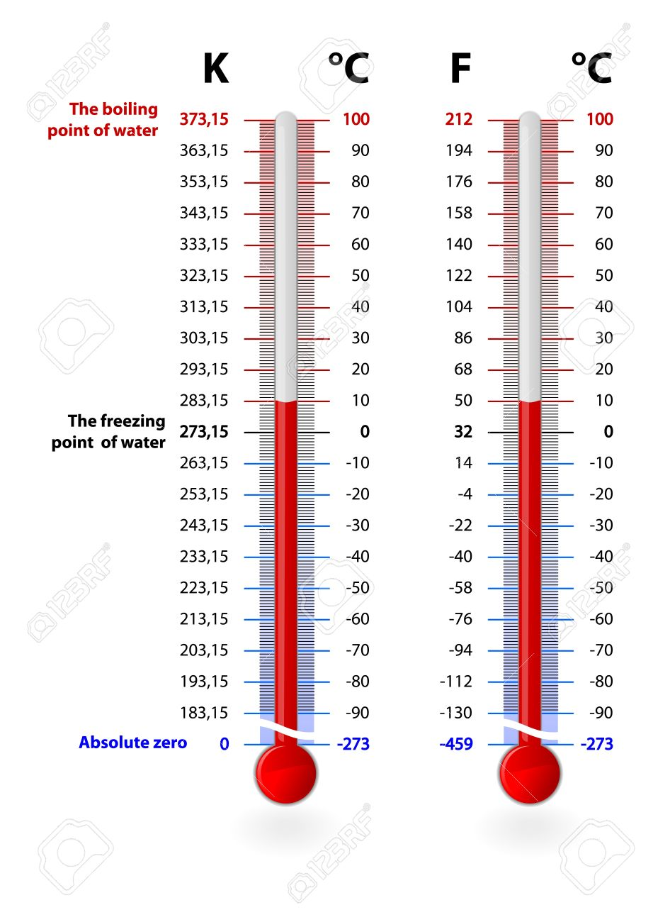
2-The Celsius(°C):
The freezing point is 0°C
The boiling point is 100°C ,
In between is divided into 100 division.
(0)°C=T-273.15
3-The Kalvin scale(°K):
Or the absolute scale
This scale has the same divisions as the Celsius but takes the 0° K at the absolute zero which is
= -273.15°C.

Slide 8
What is thermoregulation?
Thermoregulation is a process that allows your body to maintain its core internal temperature.
The average person has a baseline temperature between 98°F (37°C) and 100°F (37.8°C). Your body has some flexibility with temperature.
However, if you get to the extremes of body temperature, it can affect your body’s ability to function.
For example,
If your body temperature falls to 95°F (35°C) or lower, you have “hypothermia.” This condition can potentially lead to cardiac arrest, brain damage, or even death
If your body temperature rises as high as 107.6°F (42 °C), you can suffer brain damage or even death.

Slide 9
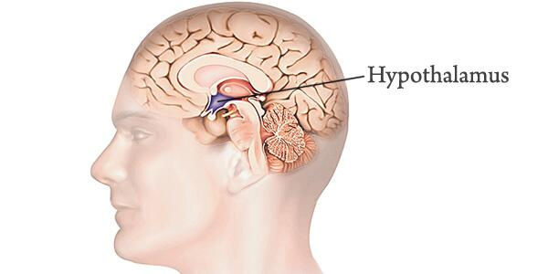
Many factors can affect your body’s temperature, such as spending time in cold or hot weather conditions.
Factors that can raise your internal temperature include:
fever
exercise
digestion
Factors that can lower your internal temperature include:
Drug use
Alcohol use
Metabolic conditions, such as an under-functioning thyroid gland
Your hypothalamus is a section of your brain that controls thermoregulation.

Slide 10
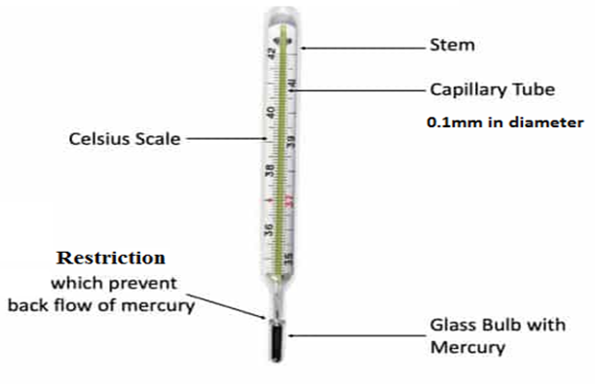
Types of thermometers
1-Glass-liquid thermometer
For mercury it expand 1.8%from (0-100°C).
•As the fever temperature is need to be precise, it has a thin capillary less than 0.1mm in diameter, which makes the mercury to rise higher per degree.

Slide 11
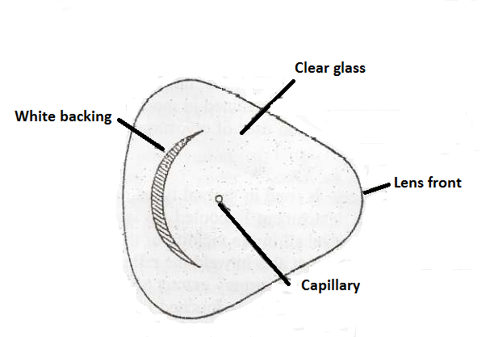
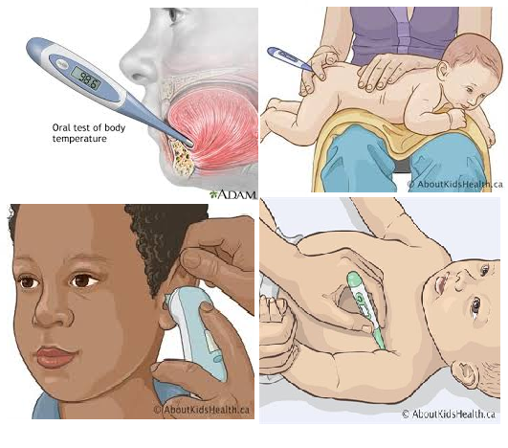
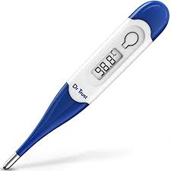
In the fever thermometer, because the mercury is raising in a very thin capillary a better vision is made by making:
The front glass tube convex to act like a magnifying lens
The back of the tube is opaque, white colored.

Slide 12
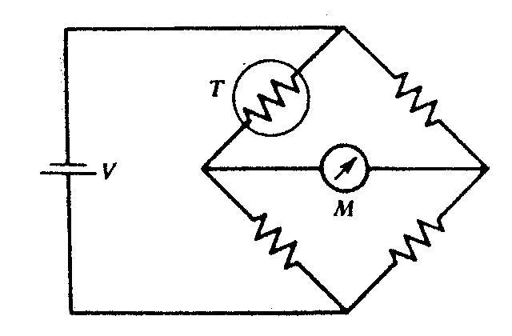
2.Thermistor
Initially the four resistors are equal, that is, the bridge is balance by symmetry, and the voltages at each end of the meter are equal and no current flows through the meter.
A temperature change causes the thermistor resistance to change. The voltage at each end become unequal, causing current to flow and the meter deflection can be calibrate for temperature.
The resistance of a thermistor T can be measure with a simple bridge circuit to determine the temperature.

Slide 13
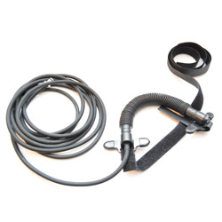
Application of thermistor in medicine
Because of their sensitivity and responds rapidly to temperature change. Thermistors are used quit often in medicine(with a thermistor it is easy to measure temperature change of (0.01 °C).
Thermistors are occasionally placed in nose to monitor the breathing rate of patients . by showing the temperature change between inspired cool air and expired warm air. This instrument called penumograph.
This instrument is called pneumograph
Pneumograph: is a device for recording velocity and force of chest movements during respiration.

Slide 14
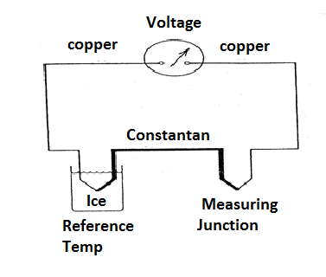
3.Thermocouple
A thermocouple consists of two different metals. If the two junctions at different temperatures, a voltage is produced that depends on the temperature difference. Usually one of junction is kept at a reference temperature such as in ice-water bath.

Slide 15
The copper-constantan thermocouple can be used to temp. from -190 to 300°C.
For 100°C temp. difference, the voltage produced is only about 0.004V.
Thermocouple can be made small enough to measure the temp of individual cells.

Slide 16
Thermography-mapping the body's Temperature
Measurements of body surface temperature indicate that the surface temperature varies from point to point depending upon
External physical factors
Internal metabolic
Circulatory processes near the skin blood flow
The simple method of obtaining a surface temperature map (thermogram). It was found that most breast cancer could be characterized by an elevated skin temperature in the region the cancer, The surface temperature above tumor was typically about 1c° higher than that above nearby normal tissue.

Slide 17
One very appealing method of obtaining a thermo gram is to measure the radiation emitted from the body in the infrared (IR) region.
The basic equation describing the radiation emitted by a body was given by Max Plank .
For our purposes the Stefan-Boltizman law is more useful .
The Stefan–Boltzmann law states that:
The total energy radiated per unit surface area of a black body in unit time(E_{r} )(known as the black-body irradiance, ),
E_{r} is directly proportional to the fourth power of the black body's thermodynamic temperature T (also called absolute temperature)

Slide 18
E_{r} = e σT⁴
T; is absolute temperature
e; is the emissivity =1 for radiation from the body
σ; is the Stefan Boltizman constant
= 5.7x${10}^{−12}$W/${cm}^{2} .K^{4}$
The irradiance E_{r} has dimensions of energy flux (energy per time per area),
The SI units of measure are joules per second per square meter, or equivalently, watts per square meter.

Slide 19
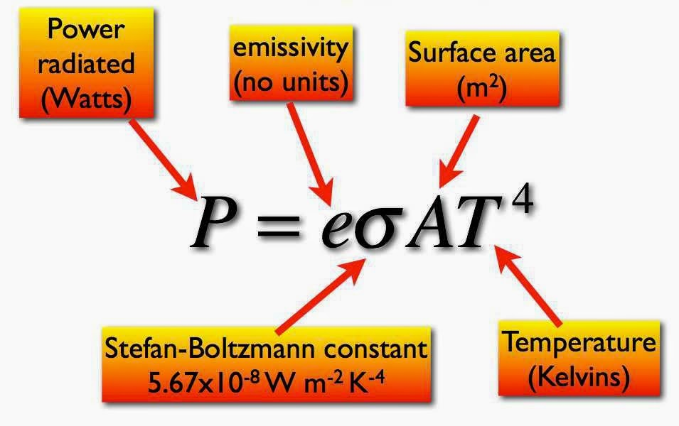
The power radiated

Slide 20
Example:
a. What is the power radiated per square centimeters from skin at a temp. of 306°K.?
E_{r} = e σT$^{4}$= (5.7×${10}^{−12}$)(306)$^{4}$= 0.05W/cm²
b. What is the power radiated from a nude body 1.75m²(1.75×10$^{4}$ cm²) in area?
power = (0.05) (1.75×10$^{4}$cm²)= 875 W

Slide 21
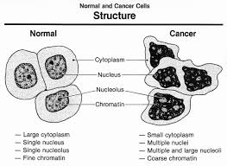
THERMOGRAPHIC
Thermography is a test that uses an infrared camera to detect heat patterns and blood flow in body tissues.
Digital infrared thermal imaging (DITI) is the type of thermography that’s used to diagnose breast cancer. DITI reveals temperature differences on the surface of the breasts to diagnose breast cancer.
The idea behind this test is that, as cancer cells multiply, they need more oxygen-rich blood to grow.
When blood flow to the tumor increases, the temperature around it rises.

Slide 22
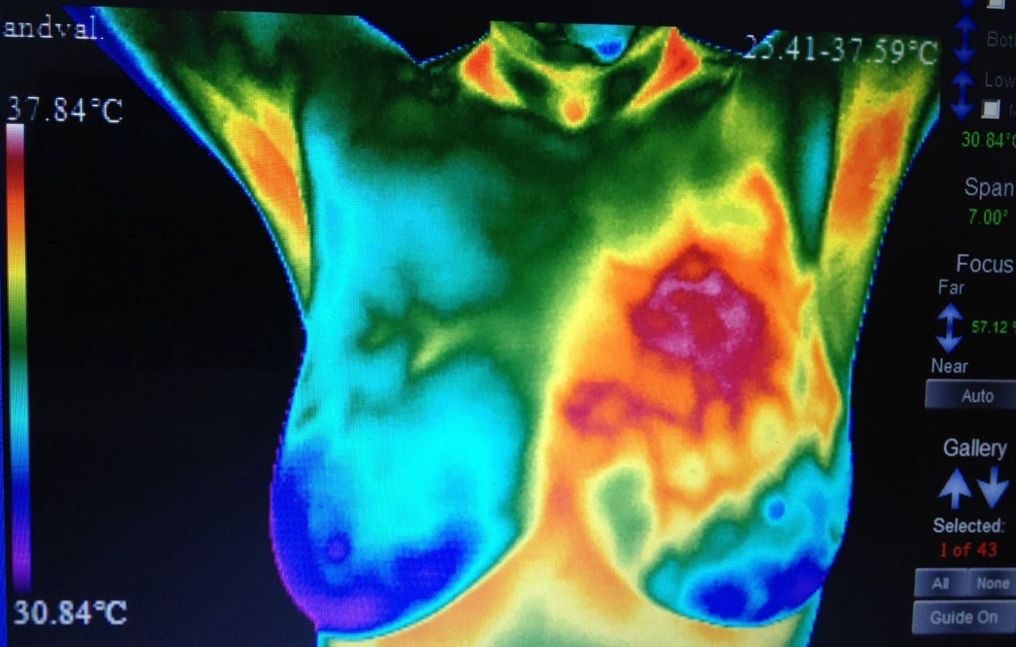
X-ray mammography has shown much more successful results to detect breast tumor of less than 1cm in diameter, but they present a radiation hazard to the body.
Thermograph has been most commonly used as an aid in detecting breast cancer.
One advantage is that thermography doesn’t give off radiation like mammography, which uses low-dose X-rays to take pictures from inside the breasts. However, thermography isn’t as effective Trusted Source as mammography at detecting breast cancer.

Slide 23
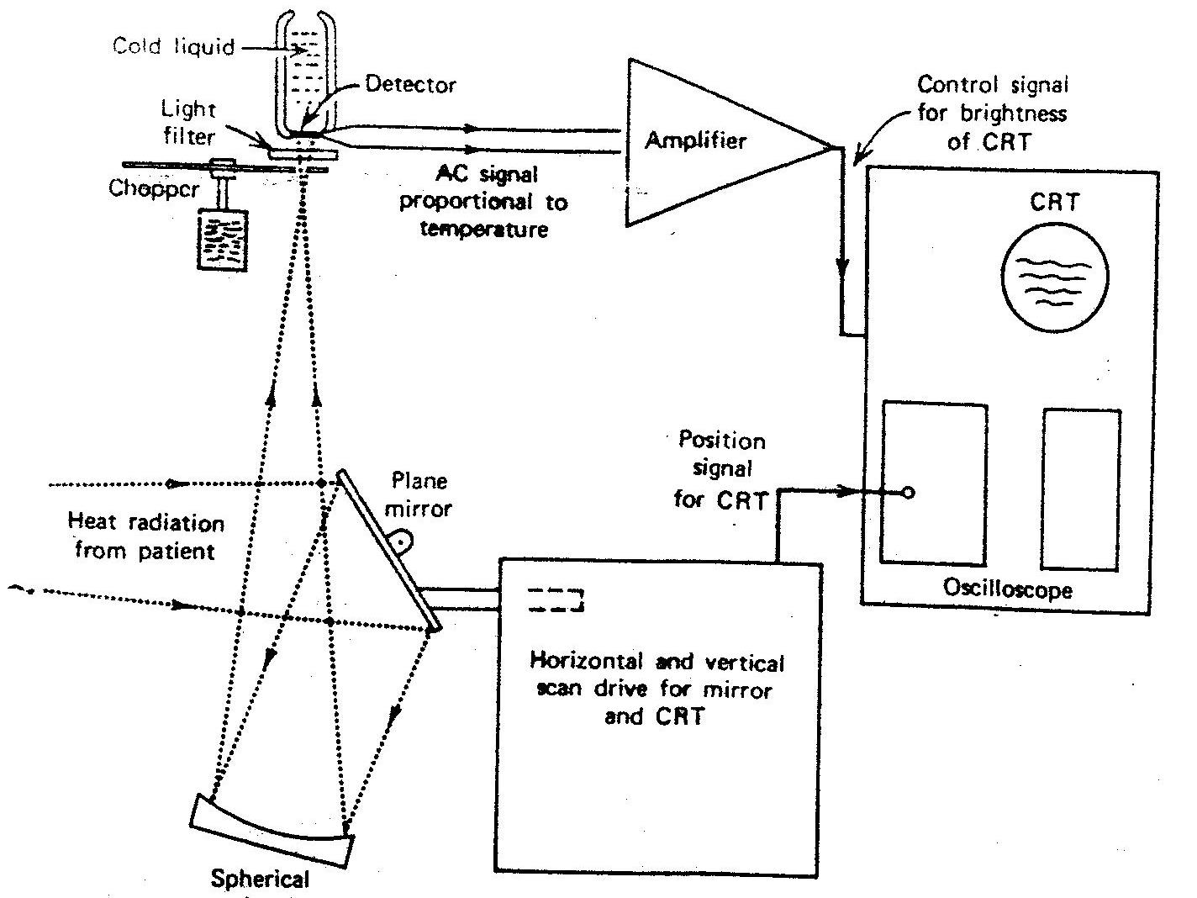
Diagram of a typical thermo graphic unit.

Slide 24
What Is Medical Thermography?
Medical Thermography uses an infrared camera that creates an image by converting heat energy that radiates from the body into a signal which can then be viewed on a monitor and printed. Using no radiation and no contact, it’s ideal for disease prevention because of the high level of sensitivity and specificity.
What can cause an abnormal scan?
Abnormal heat can be caused by cancer, inflammation, toxins, hormonal imbalance, nerve damage, and lack of circulation

Slide 25
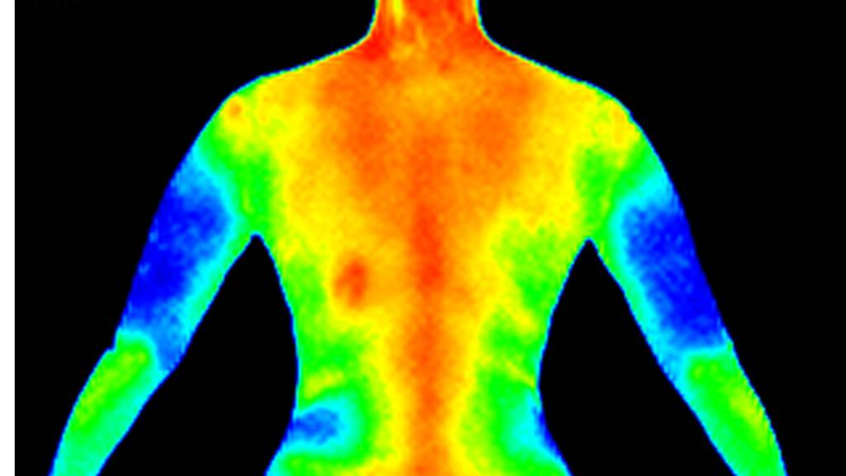
More red means more heat, which comes from more blood flow and metabolic activity.
That’s why your head typically appears more red that your elbow, because your brain should have more activity than your elbow.

Slide 26
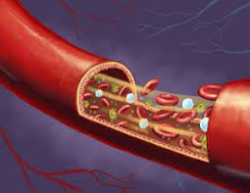
Heat Therapy
Heat therapy works by increasing the temperature around an area of your body that is hurting — such as a muscle. When the body’s temperature rises, it improves blood flow and circulation.
Since it improves blood flow and circulation, it can be an effective way to heal damaged tissues, as well.

Slide 27
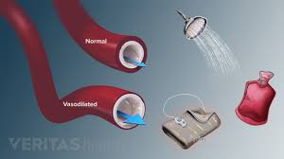
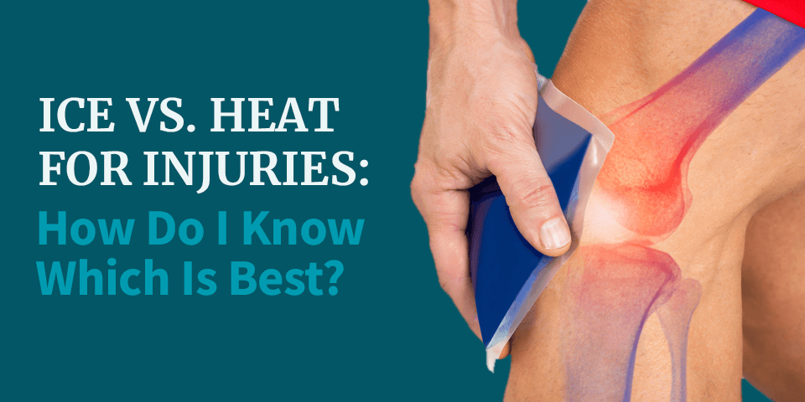
Heat Therapy
Two therapeutic effects take place in a heated area;
Primary : There is an increase in metabolism resulting in a relaxation of the capillary system (vasodilation).
There is an increase in blood flow as blood moves in cool to the heated area.
The relaxation and increased blood flow are beneficial to damage tissue.

Slide 28
The physical methods of producing heat in the body are:
The conducted and convection method
There are two different types of heat therapy: dry heat and moist heat. Both types of heat therapy should aim for “warm” as the ideal temperature instead of “hot.”
Dry heat (or “conducted heat therapy”) includes sources like heating pads, dry heating packs, and even saunas. This heat is easy to apply.
Moist heat (or “convection heat”) includes sources like steamed towels, moist heating packs, or hot baths. Moist heat may be slightly more effective as well as require less application time for the same results.

Slide 29
Heat can transfer by conduction, the quantity of heat transfer depends on:
The temp. difference,
The time of contact,
The area of contact, and
The thermal conductivity of the materials.

Slide 30
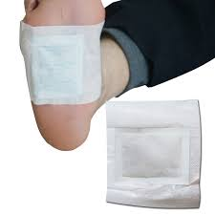
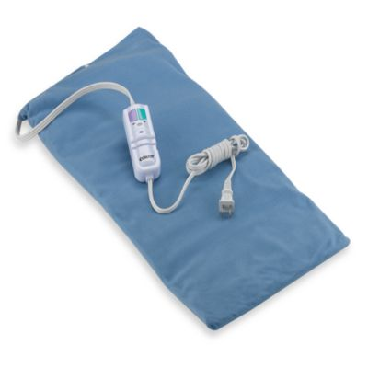
This can be done by several ways such as hot bath, hot packs, and electric heating pad.
This can lead to local surface heating and using in the treatment of arthritis, neuritis, strains, sinusitis and back pain.

Slide 31
2.Radiant (IR) heat
Is used for heating of the body.
Wavelengths used between 800 and 40,000nm.
The wave penetrate the skin about 3mm and increase the surface temperature.
Excessive exposure causes reddening (erythematic) and some times swelling (edema).

Slide 32
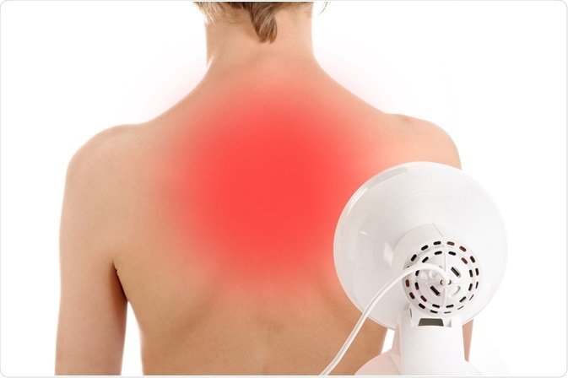
Irradiative heating is generally used for the same conditions as conductive heating , but is considered to be more effective because the heat penetrates deeper.

Slide 33
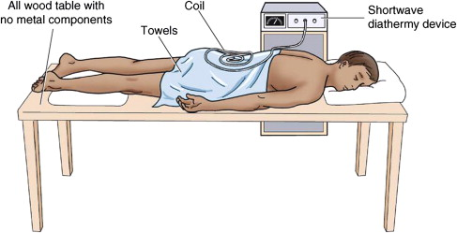
3. Alternating electric current (short-wave diathermy).
Heat from diathermy penetrates deeper into the body than radiant and conductive heat.
It is useful for internal heating and has been used in the treatment of inflammation of skeleton, bursitis(fluid filled sacs) and neuralgia.

Slide 34
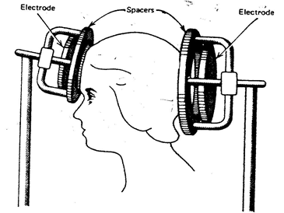
Methods of short wave diathermy
Two different methods are used for transferring the electromagnetic energy into the body in short wave diathermy.
A- In one, the part of the body to be treated is placed between two metal plate-like electrodes energized by the high –frequency voltage.
The body tissue between the plates acts like an electrolytic solution.
Location of capacitor plates for short wave diathermy.

Slide 35
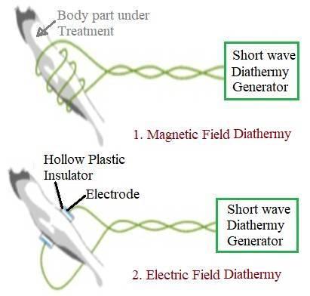
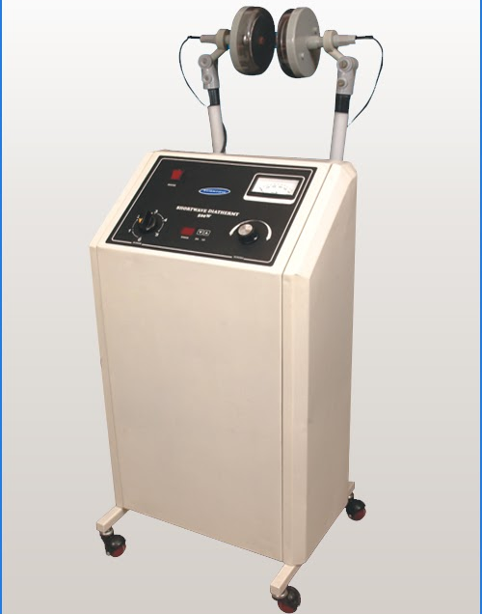
The charged particles are attracted to one plate and the other depending upon the sign of the alternating voltage on the plates:
This results in resistive heating (The resistance to electrical flow that exists in the tissue causes the formation of heat; resulting in an increase in temperature of water in tissue).

Slide 36
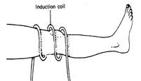
B- The second method of transferring short wave energy into the body is magnetic induction.
A coil is placed around the body region to be treated.
The alternating current in the coil results in an alternating magnetic field in the tissue, producing joule heating in the body region being treated.
Location of induction
coil around knee for
short-wave.

Slide 37
It has been used in:
Relieving muscle spasms,
Pain from protruded intervertebral discs,
Degenerative joint disease, and
Bursitis .

Slide 38
4. Microwave diathermy
The microwaves are produced in a special tube called a magnetron and are then emitted from the applicator (antenna).
The antenna is usually designed so that it can be placed several inches from the region to be treated.
Microwaves from antenna penetrate deep into the tissue, causing a temperature rise and deep heating.
The frequency used in microwave diathermy is 2450 MHz, causing more uniform heating around body region.
Microwave is used in the treatment of fractures, sprains and strains, bursitis, injuries to tendons, and arthritis.

Slide 39
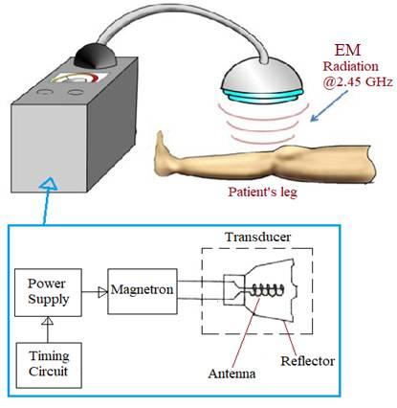
Microwave diathermy

Slide 40
5.Ultrasound waves
Are also used for deep heating of body tissue.
These waves are completely different from electromagnetic waves.
They produce mechanical motion like audible sound waves except the frequency is much higher (usually near 1MHz).
In ultrasonic diathermy, power levels of several watts per square centimeter are usually used and the sound source is directly in contact with the body.
As the ultrasonic wave move through the body the practices in the tissues move back and forth.
The movement is similar to micro massage and results in heating of the tissues.

Slide 41
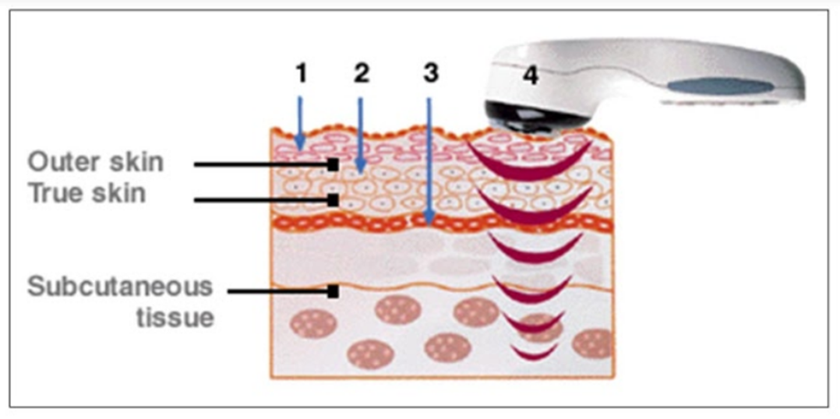
Ultrasonic therapy or ultrasonic diathermy products used in physical therapy equipment produce high-frequency sound waves that travel deep into tissue and create gentle therapeutic heat.
Ultrasonic diathermy is intended to generate deep heat within body tissues for the treatment of selected medical conditions such as pain, muscle spasms and joint contractures.

Slide 42
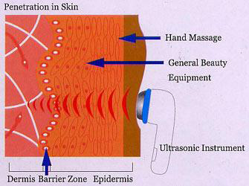
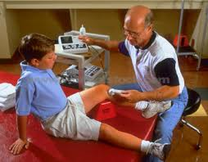
Ultrasonic heating has been found useful in relieving the tightness and scarring that often occur in joint disease.
It greatly aids joints that have limited motion. It useful for depositing heat in the bones because the absorb ultrasound energy more effectively than does soft tissue

Slide 43
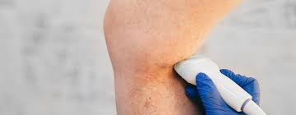
Ultrasound and electromagnetic diathermy (both shortwave and microwave) have useful roles in treating sports injuries. Ultrasound can control inflammation, improve collagen elasticity, and deliver medication to selected tissues. Electromagnetic diathermy is an alternative to ultrasound for alleviating muscle or joint contractures, muscle spasm, and pain. Knowing the indications and contraindications of these modalities can help physicians make the best use of these treatment options.

Slide 44
Thank you

